Slide 1
Unit 2
Richard Palmer

Slide 2
## ## Attaching package: 'dplyr'
## The following objects are masked from 'package:stats': ## ## filter, lag
## The following objects are masked from 'package:base': ## ## intersect, setdiff, setequal, union

Slide 3
Question 1
Show the number of players per position
BBall %>% filter(position != '') %>% ggplot() + geom_bar(mapping=aes(x=position)) + ggtitle("Count per position")

Slide 4
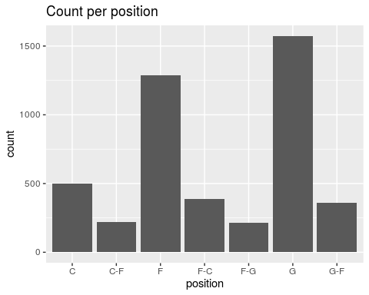

Slide 5
Question 2
Compare the distribution of weight of centers with that of the weight of forwards
BBall %>% filter(position == 'C' | position == 'F') %>% ggplot(aes(x=weight)) + geom_histogram(bins=20) + ggtitle("Distribution of Weight for Centers and Forwards") + facet_wrap(~position)
## Warning: Removed 3 rows containing non-finite values (stat_bin).

Slide 6
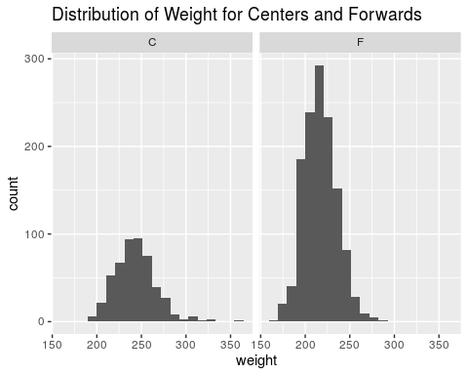

Slide 7
Question 3
Compare the distribution of the height of centers with that of the height of forwards
BBall %>% filter(position == 'C' | position == 'F') %>% ggplot(aes(x=height_inches)) + geom_histogram(bins=20) + ggtitle("Distribution of Height for Centers and Forwards") + facet_wrap(~position)

Slide 8
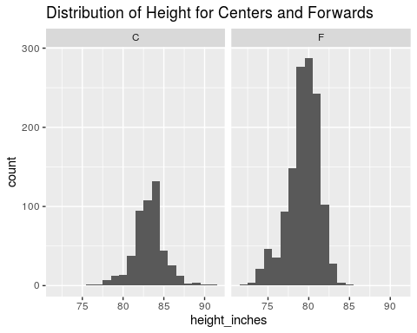

Slide 9
Question 4
Investigate distribution of height across all positions
BBall %>% filter(position != "") %>% ggplot(aes(x=height_inches)) + geom_histogram(bins=20) + ggtitle("Distribution of Height for all positions") + facet_wrap(~position)

Slide 10
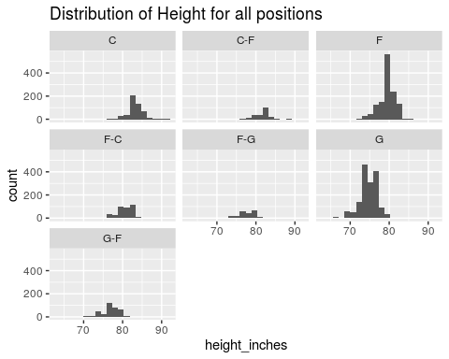

Slide 11
Question 5
Investigate how a players height is related to his weight
BBall %>% ggplot(aes(x=weight,y=height_inches)) + geom_point() + ggtitle("Height versus Weight");
## Warning: Removed 6 rows containing missing values (geom_point).

Slide 12
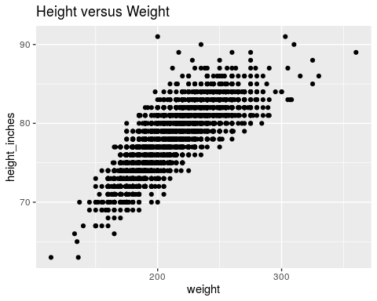

Slide 13
Question 6
Is there any difference in height/weight relationship among positions?
BBall %>% ggplot(aes(x=weight,y=height_inches,color=position)) + geom_point() + ggtitle("Height versus Weight");
## Warning: Removed 6 rows containing missing values (geom_point).

Slide 14
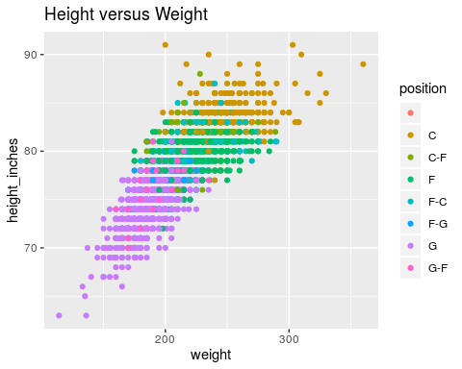

Slide 15
Question 7
Is there any evidence that height has changed over the years?
BBall %>% ggplot(aes(x=year_start,y=height_inches)) + geom_point() + ggtitle("Height versus starting year")
## Warning: Removed 1 rows containing missing values (geom_point).

Slide 16
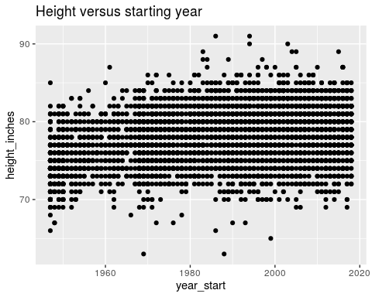

Slide 17
## Question 8 3D plot of height versus weight, colored by position

Slide 18
Slide with Bullets
Bullet 1
Bullet 2
Bullet 3

Slide 19
Slide with R Output
summary(cars)
## speed dist ## Min. : 4.0 Min. : 2.00 ## 1st Qu.:12.0 1st Qu.: 26.00 ## Median :15.0 Median : 36.00 ## Mean :15.4 Mean : 42.98 ## 3rd Qu.:19.0 3rd Qu.: 56.00 ## Max. :25.0 Max. :120.00

Slide 20
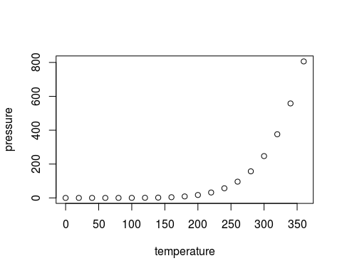
Slide with Plot

